Slide 1
Development of an Automated Strategy to Calibrate Crystal Plasticity Subroutines for ABAQUS, Using Machine Learning Approaches, and Neural Networks
Orkun Karagüllü
Examiner : Prof. Dr. Ing. Münstermann, Dr. Ing Michael Dölz
Supervisor: Henrich Manuel, M.Sc.

Slide 2
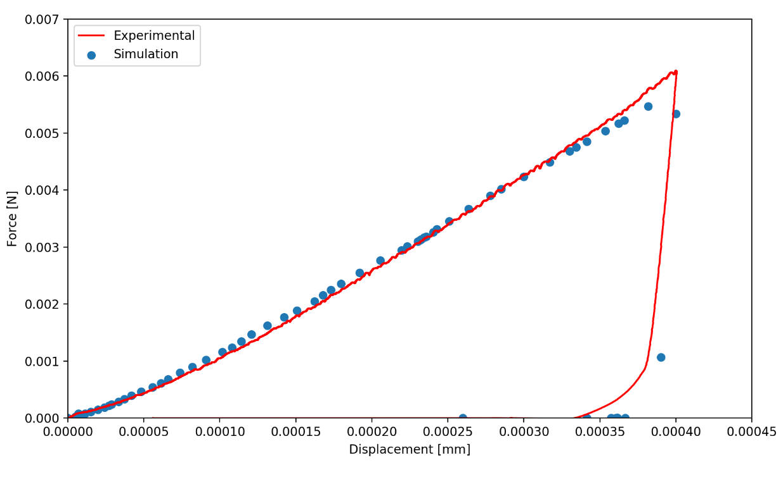
Motivation and Aim
Conventional crystal plasticity (CP) calibration routines are user dependent, and time consuming.
Decreasing the user dependency via using machine learning algorithms.
Automate the process for a faster and parallel calibration routines.
A robust and flexible model that can be used in different phases.
Force Displacement Curve

Slide 3
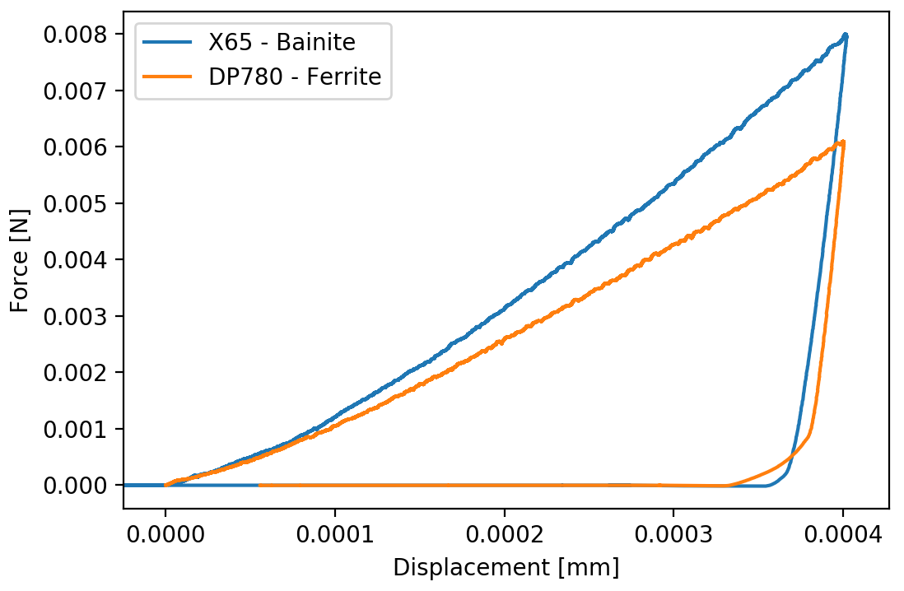
Nanoindentation Test
Nanoindentation results of bainite and ferrite phases have been obtained from the X65 Pipeline (PL) and DP780 Dual-Phase (DP) steels.
Piezoelectric Sensor

Slide 4
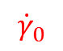
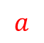
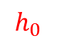
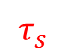
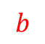
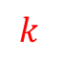
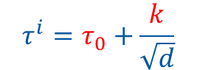
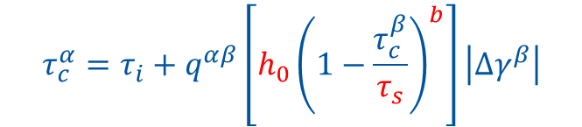
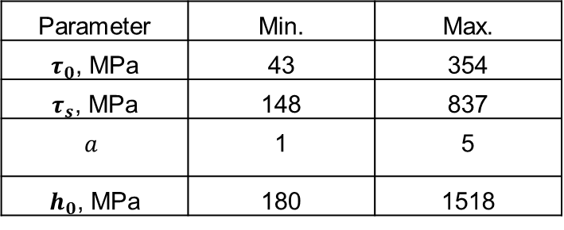
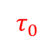
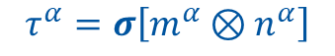

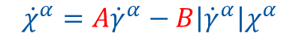
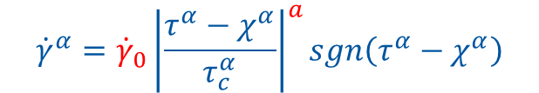

Crystal Plasticity Model
Slip rate
$$τ_{0}$$
$$A$$
$$B$$
$${\dot{γ}}^{α}={\dot{γ}}_{0}{\left|\frac{τ^{α}−χ^{α}}{τ_{c}^{α}}\right|}^{a}sgn\left(τ^{α}−χ^{α}\right)$$
Back stress evolution law
$${\dot{χ}}^{α}=A{\dot{γ}}^{α}−B\left|{\dot{γ}}^{α}\right|χ^{α}$$
Parameter | Min. | Max.
$τ_{0}$, MPa | 43 | 354
$τ_{s}$, MPa | 148 | 837
$$a$$ | 1 | 5
$h_{0}$, MPa | 180 | 1518
Resolved shear stress
$$τ^{α}=σ\left[m^{α}⊗n^{α}\right]$$
Critical resolved shear stress
$$τ_{c}^{α}=τ_{i}+q^{αβ}\left[h_{0}{\left(1−\frac{τ_{c}^{β}}{τ_{s}}\right)}^{b}\right]\left|{Δγ}^{β}\right|$$
Initial critical resolved shear stress
$$τ^{i}=τ_{0}+\frac{k}{\sqrt{d}}$$

Slide 5
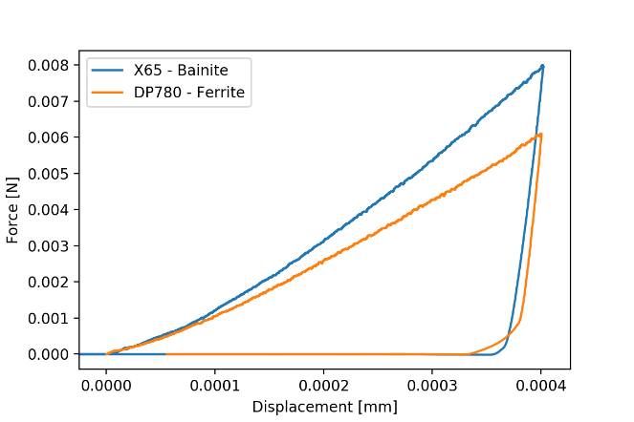

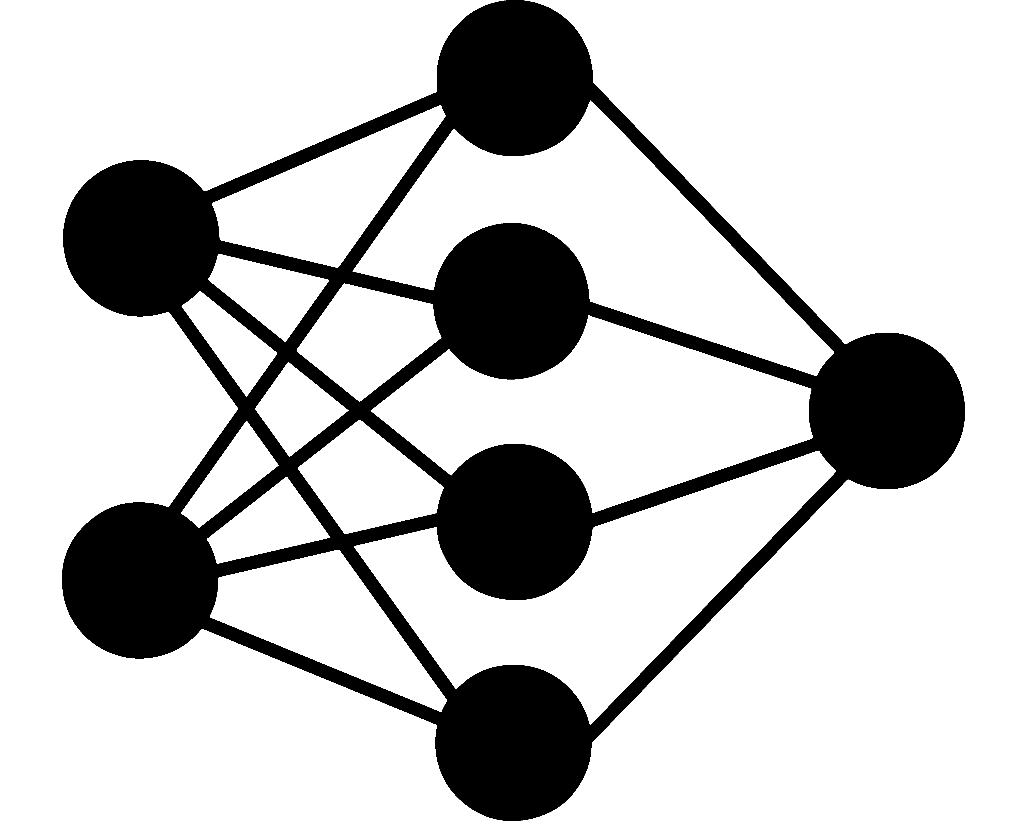
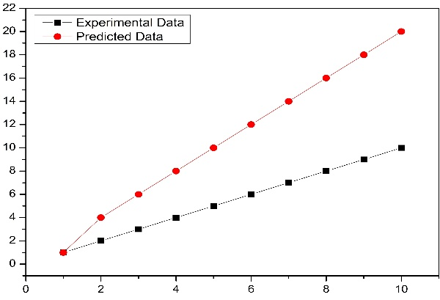
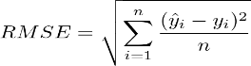
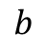
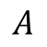
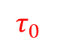
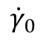
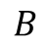
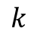
Artificial Intelligence (AI) Model
$$τ_{0}$$
Simulation Input
(CP Parameters)
Simulation Output
(Force-Displacement Data)
$$A$$
$$B$$
$$k$$
Training Data
$$b$$
$${\dot{γ}}_{0}$$
AI Simulation Input
(CP Parameters + Displacement)
Experimental (True) Data
AI Conducted Simulation Output
(Force Data)
Verification
Best 25 AI Conducted Simulations
Comparison

Slide 6
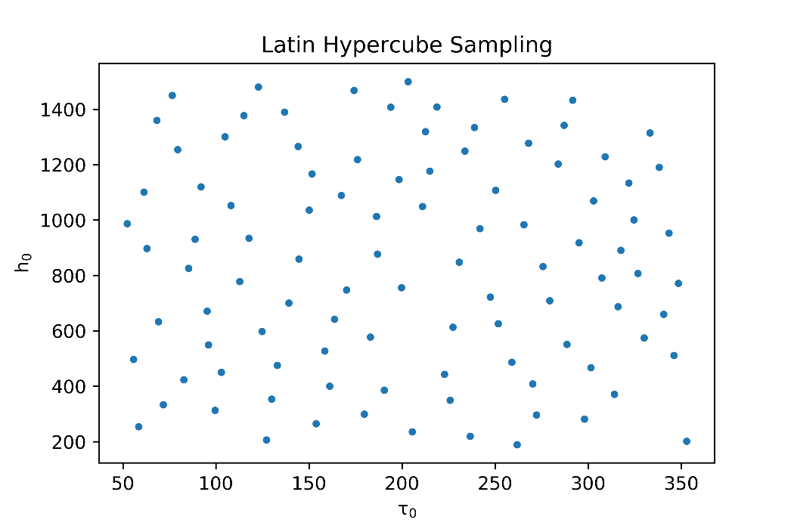
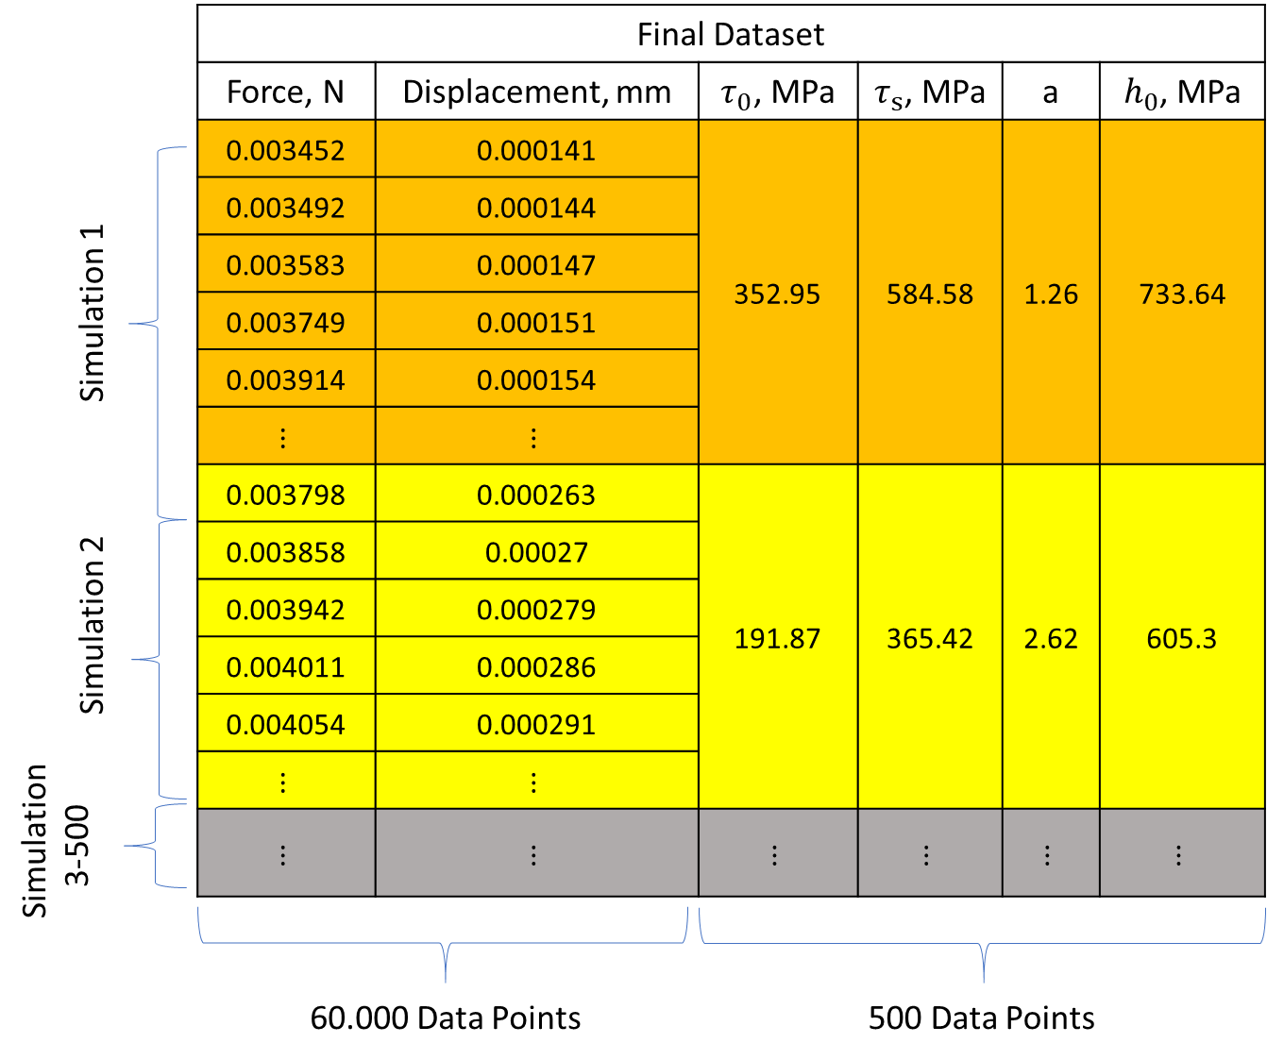
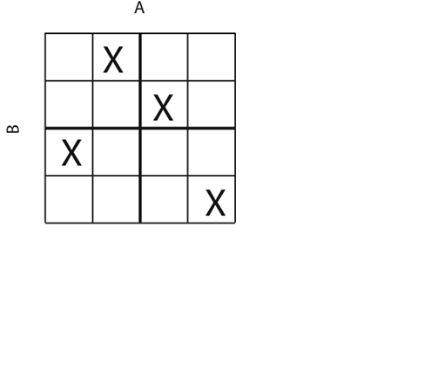
AI Model
Latin Hypercube Sampling
Automation
Script

Slide 7
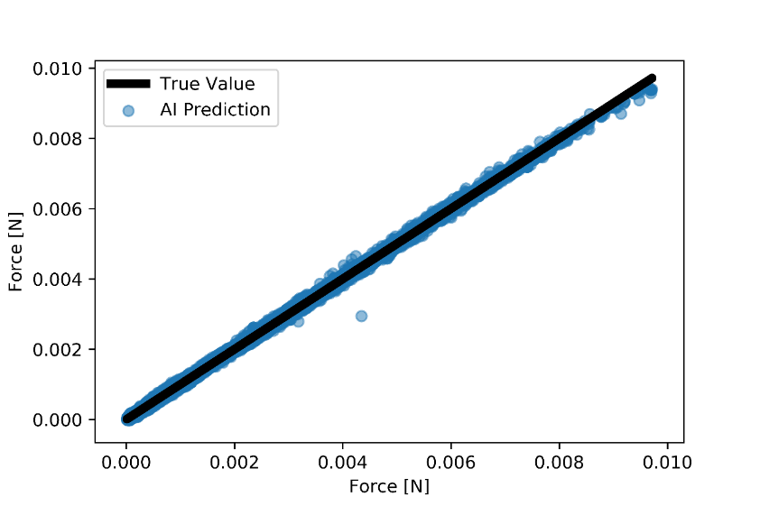
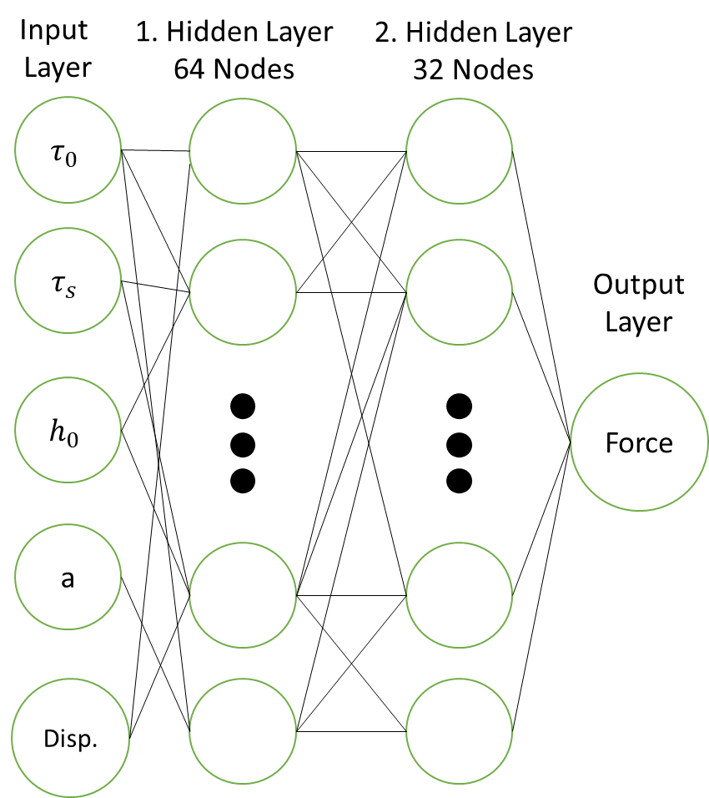
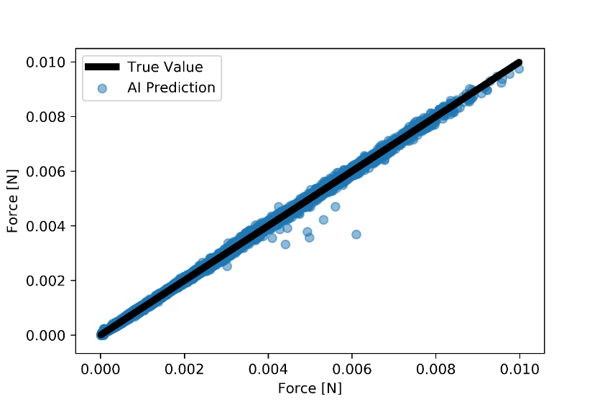
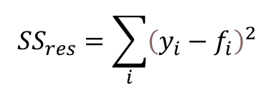
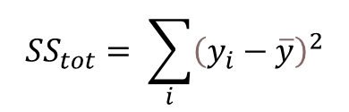
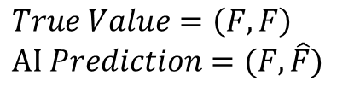
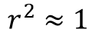
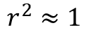
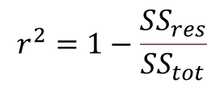
AI Model
DP Steel
$$True Value=\left(F,F\right) \\ AI Prediction=(F,\hat{F})$$
$${SS}_{tot}= \sum_{i}{{\left(y_{i}−\overline{y}\right)}^{2}}$$
$$r^{2}≈1$$
$${SS}_{res}=\sum_{i}{{\left(y_{i}−f_{i}\right)}^{2}}$$
PL Steel
$$r^{2}=1−\frac{{SS}_{res}}{{SS}_{tot}}$$
$$r^{2}≈1$$

Slide 8


AI Model
$$τ_{0}$$
Simulation Input
(CP Parameters)
Simulation Output
(Force-Displacement Data)
$$B$$
Training Data
$$A$$
AI Simulation Input
(CP Parameters + Displacement)
Experimental (True) Data
AI Conducted Simulation Output
(Force Data)
Verification
Best 25 AI Conducted Simulations
Comparison

Slide 9
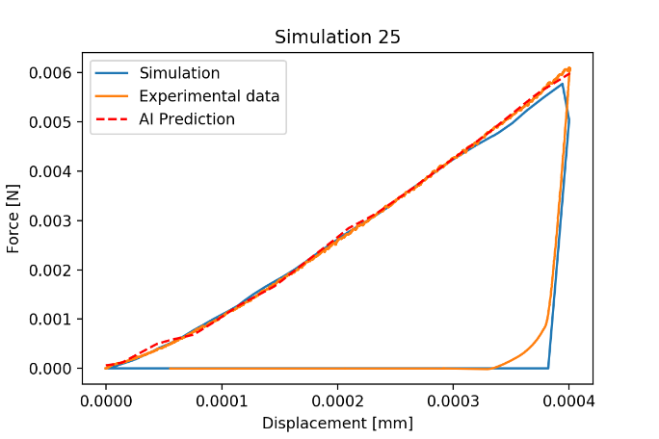
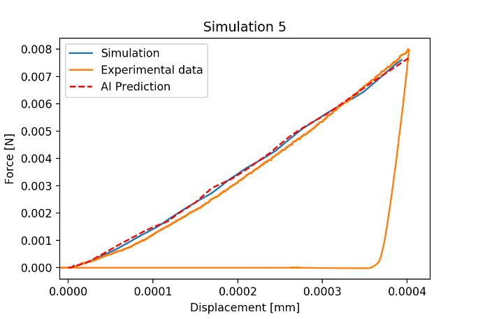
Best AI Conducted Simulation for DP Steel
AI model able to optimize CP parameters of both phases.
The flexibility criteria is achieved.
DP Steel
PL Steel

Slide 10
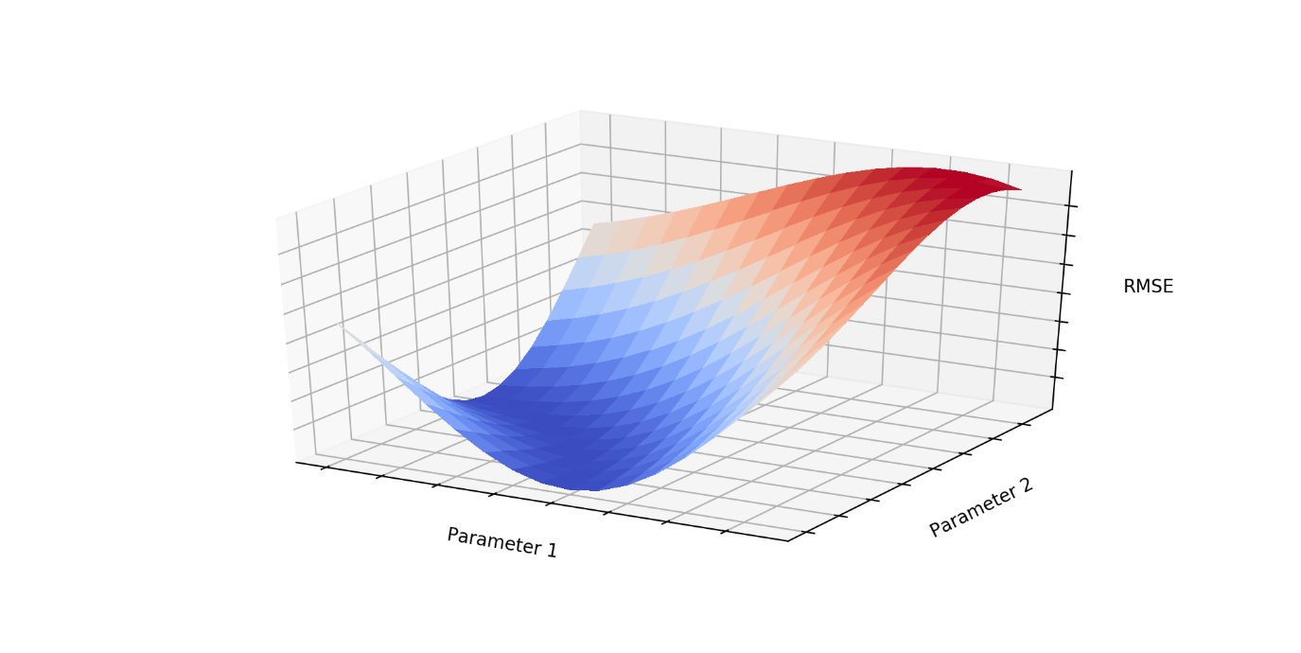
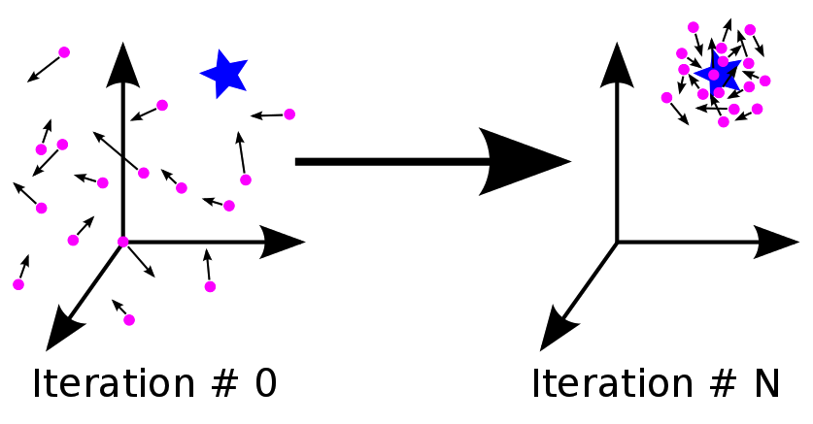
Response Surface Model
Gloabal Sensitivity Analyze
Statistical Method to Generate Samples
Abaqus CPFEM Model
Performing Batch of Simulations
Latin Hypercube Sampling
Morris Method
Root Mean Square Error
Error Function
Polynominal Fitting
Creating Response Surface
Particle Swarm Optimization
Optimizing Simulation Parameters
PSO

Slide 11
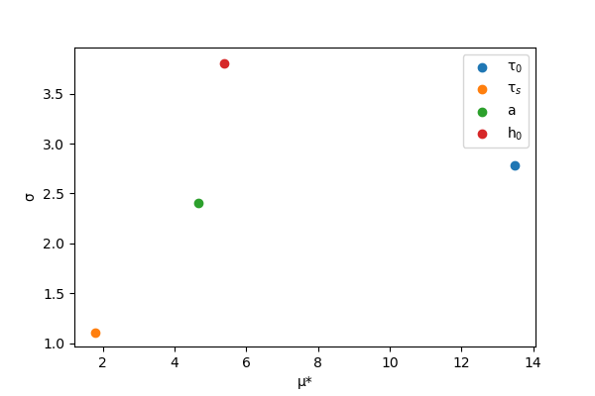
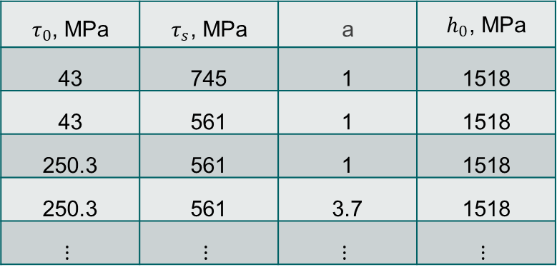
Morris Sensitivity Analysis
One step at a time method.
Measures elementary effect of each parameter on the output.
$τ_{0}$, MPa | $τ_{s}$, MPa | a | $h_{0}$, MPa
43 | 745 | 1 | 1518
43 | 561 | 1 | 1518
250.3 | 561 | 1 | 1518
250.3 | 561 | 3.7 | 1518
$$⋮$$ | $$⋮$$ | $$⋮$$ | $$⋮$$

Slide 12
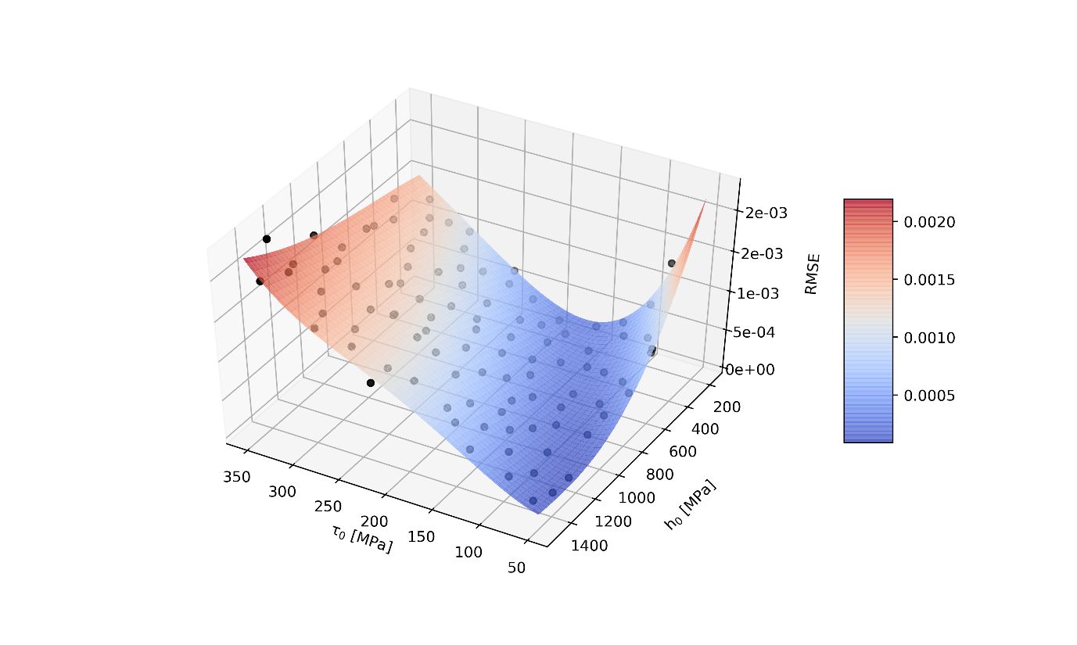
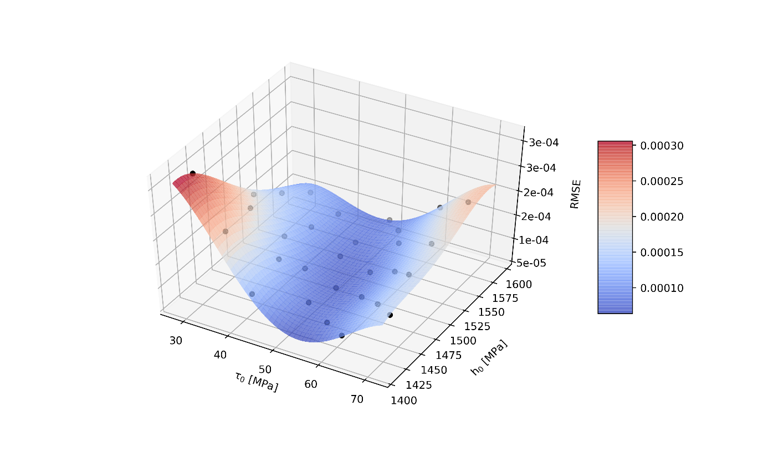
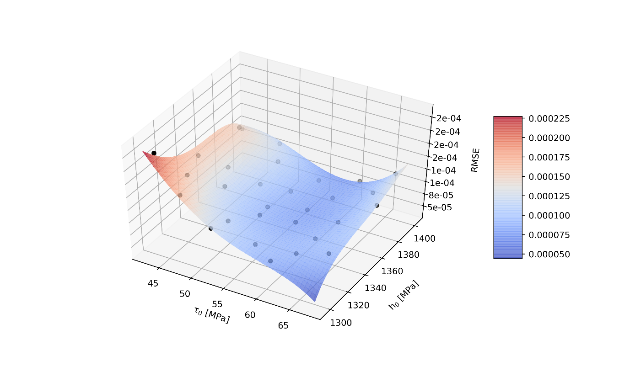
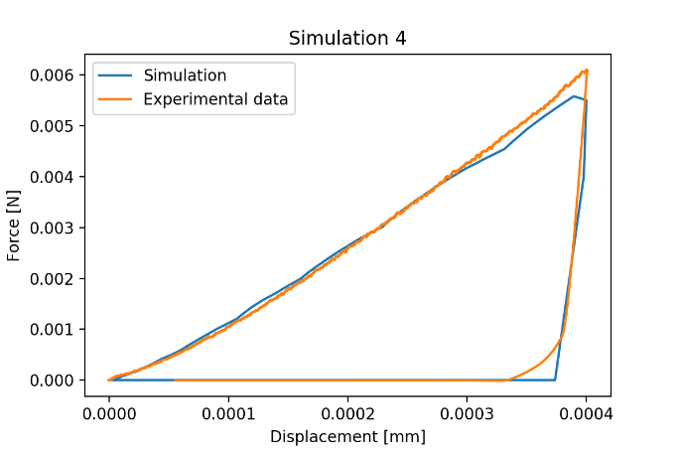
RS for DP Steel
Exploration
2. Exploitation
1. Exploitation

Slide 13

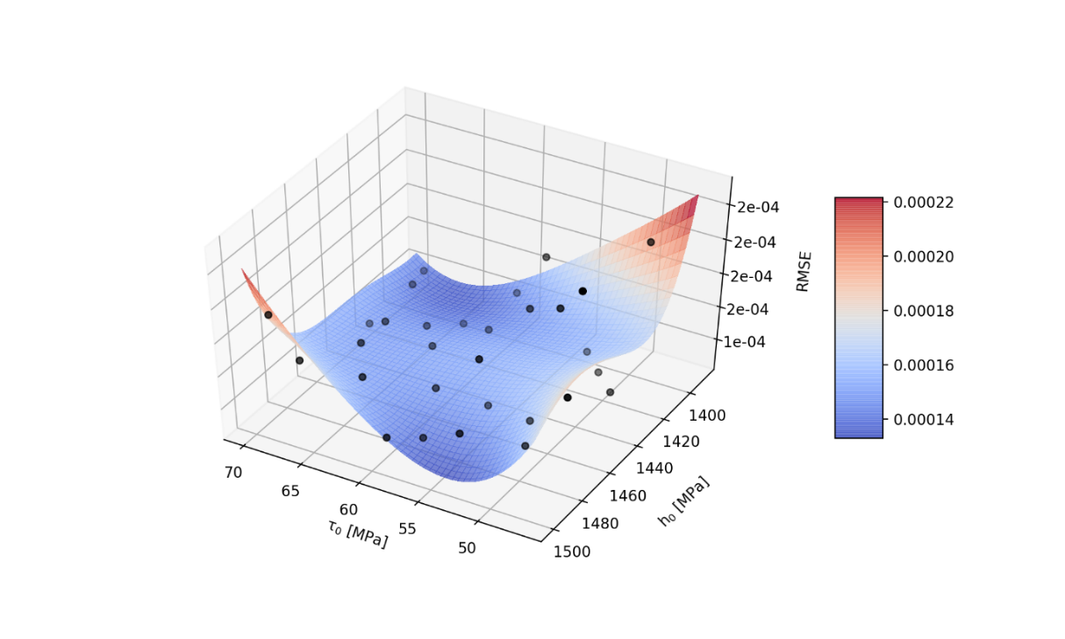
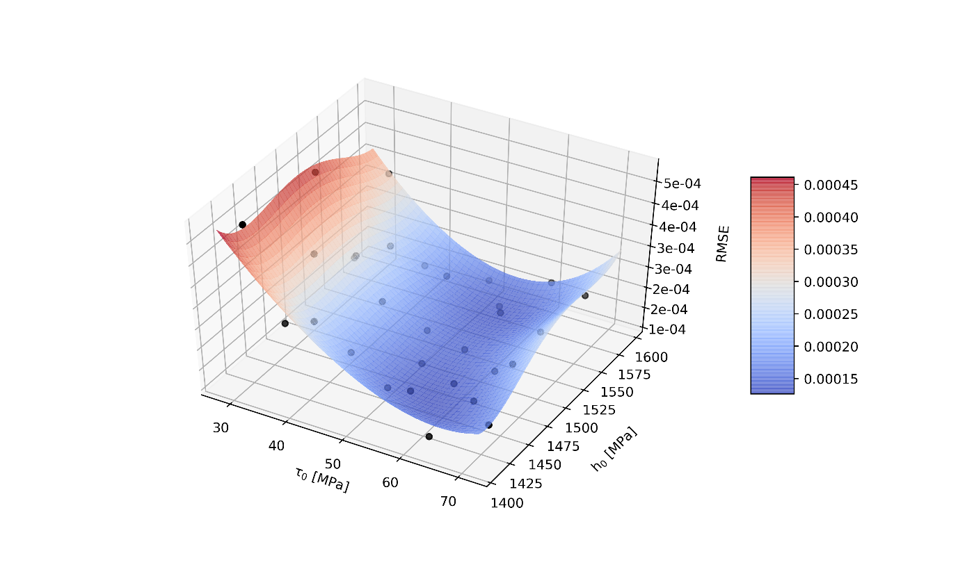
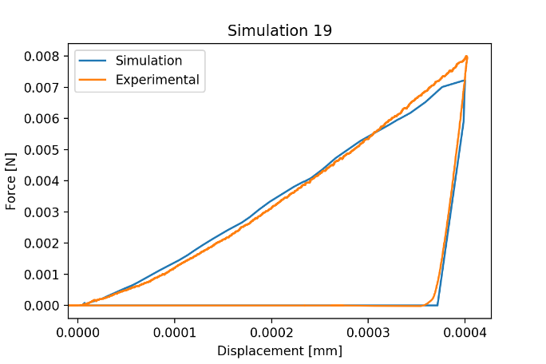
RS for PL Steel
Exploration
2. Exploitation
1. Exploitation

Slide 14



Error Function

Slide 15



Weighted Error
Weighted Error = WE
Area Under the Curve = AUC
Difference in Maximum Load = DML
$$WE= 0.8∗\left(AUC\right)+0.1∗\left(DML\right)+0.1∗\left(RMSE\right)$$
Source: LI, H., L. GUTIERREZ, H. TODA, O. KUWAZURU, W. LIU, Y. HANGAI, M. KOBAYASHI und R. BATRES. Identification of
material properties using nanoindentation and surrogate modeling .

Slide 16
RS for DP Steel
Exploration
2. Exploitation
1. Exploitation

Slide 17




Conclusion
AI Results
RS Results
User dependency
Computational cost
Required time
Flexibility
Accuracy

Slide 18


Calibration of CP Parameters
Nanoindentation test
Force – Displacement Curve
Pile Up
CPFEM
Validation on Hysterisis Loop

Slide 19



Intelligent Calibration of CP-Parameters
Experimental vs. simulation pileups:
Measured with Atomic Force Microscopy
Extracted coordinates from penetrated surface

Slide 20



Intelligent Calibration of CP-Parameters
$$τ_{0}$$
Simulation Output
(Force-Displacement Data
+Pileup Data)
Simulation Input
(CP Parameters)
$$A$$
$$B$$
$$k$$
Training Data
$$b$$
$${\dot{γ}}_{0}$$
AI Simulation Input
(CP Parameters + Displacement + Pileup)
AI Conducted Simulation Output
(Force Data)
Experimental (real) Data
Best 25 AI Conducted Simulations

